Slide 1


Welcome to
Red Kites
Class
Mrs Spencer
Mrs McLoughlin (TA)
Miss Foulsham (TA)
Ms Kearney (LSA)
Mrs Smith (LSA)
Miss Smith (LSA)

Slide 2
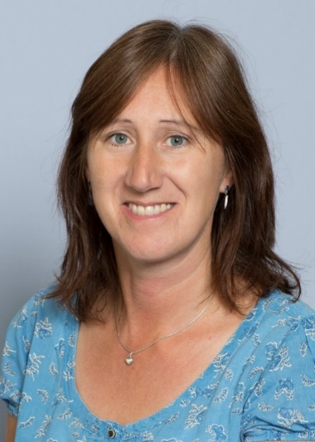
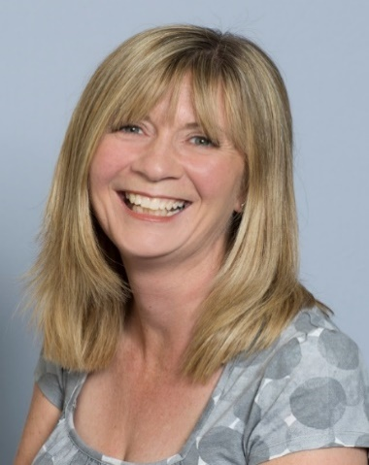
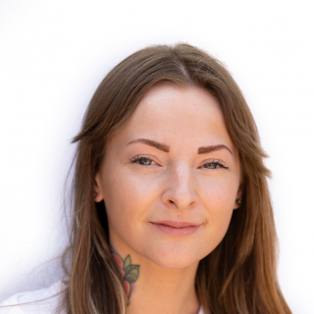
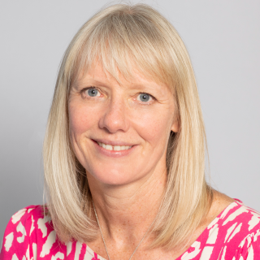
Mrs Spencer
Mrs McLoughlin
Miss Foulsham
Mrs Shrimpton

Slide 3
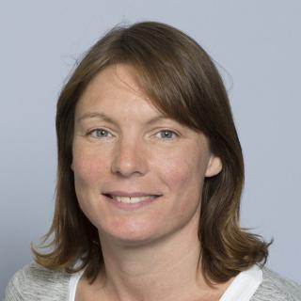
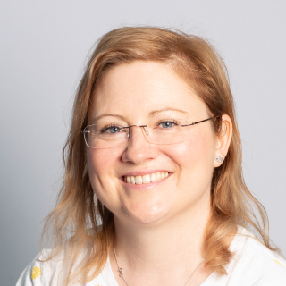
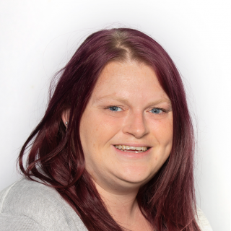
Ms Kernan
Mrs Smith
Miss Smith

Slide 4
5
Independence
It is lovely to see the
children entering
the classroom
independently
in the mornings and they
have settled really well. Collection from
school
Please let the school know
of any changes to the
collection of your child in advance.

Slide 5
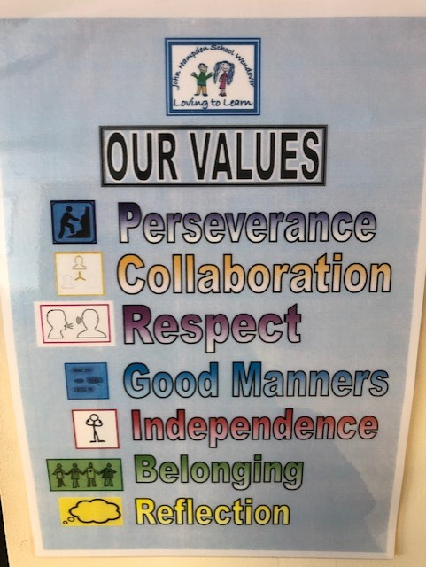
Topics
Each week we are choosing a different text based on one of our school values.

Slide 6
Activities
The children are enjoying completing a range of activities both inside and outside of the classroom.

Slide 7
Classroom
We have a range of rewards to encourage children to do the best that they can including stickers which they love to receive.

Slide 8
Transition
In these early weeks we will be focusing on settling activities that encourage self esteem and
confidence as well as helping them to develop positive relationships with their peers.

Slide 9
Book Changing
For the time being,
books will be changed
once a week.
Your child will be told on
which day their books
will be changed.

Slide 10
Home/School Diary
Please sign the diary when you
have heard your child read their book.
Mrs Spencer will sign
the diaries on
a Friday.

Slide 11
Home/school Diary
This can be used to
communicate messages.
Please tell your child to show
us their diary if there is a
message.
Smiley faces are for your
child to complete daily
and reflect on their day
with you.

Slide 12
High Frequency &
Tricky Words
Your child will have been given (in their book bag), a list of words. They will be familiar with some of these words from their work in Year 1. Please can your child practise reading these words with your support.
When your child becomes confident with reading these words they can then move on to practise spelling them.

Slide 13
The Library Book Club
Later on this half term, your child will have the opportunity to take a library book home of their choosing. This will happen on a Friday.
Please can they also return their book on a Friday so that they may be issued with a new one.

Slide 14
Homework
Once homework is issued
it will be set fortnightly.
This is a necessary part of your child’s learning as it enables them the opportunity to apply skills taught in a creative, open ended way linked to their personal interests.

Slide 15
Homework
By supporting your child
with their homework, you are providing them valuable guidance that will help them to complete a piece of
work they are proud of.
We are available to answer any questions you may have.

Slide 16
Homework
We ask that any written work is recorded in pencil as they would do in school.
Homework should be presented with care and handed in on time.
If for any reason, this presents an issue, please let us know.

Slide 17
Spellings
Once spellings have been issued, they will be set on a Friday
and the children will be
tested on the following
Friday.
Further information will follow in due course.

Slide 18
P.E.
Thursday
Please ensure your child
has appropriate, named kit
including
plimsolls or trainers,
jogging bottoms
and a sweatshirt.
Long hair tied back.
Earrings taped or
removed that day.

Slide 19
End of the day
Children will continue to be collected from the classroom. If you are running late, do let the office know if you have asked someone else to collect your child.
Also, a polite reminder to avoid parking on the school campus.

Slide 20
Contact Details
Please inform the
school if your
contact details
change.

Slide 21
Communication
Please look out for our school newsletter and our weekly what we are learning sheet via parentmail/website.
Do check your child’s book bag
& the school website for
additional letters
and information.
Please respond promptly when necessary.

Slide 22

Jumpers and Cardigans!
Please ensure that all uniform is named including PE kit.

Slide 23
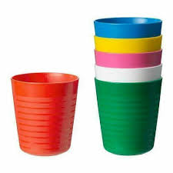
Water
We encourage all children to come to school with a named water bottle. We do offer water with snack before break and
on request.

Slide 24
Medical
Please inform the
school if there are any medical changes we
might need to know about. Also please ensure we have spare, in-date epipens/inhalers at school.

Slide 25
Allergies
A reminder about packed lunches. Please can we remind parents that there should be no nuts, no sesame or chocolate in lunchboxes.
We have children in our class that have nut and sesame allergies and will require an epipen.

Slide 26
Holidays
Year 2 is a very
busy year. It is the final
year of Key Stage 1 and
we assess the children
regularly throughout the
Year with a particular focus
in May.
Unless there are
exceptional circumstances,
please do not take your
child out of school during
term time.

Slide 27

We will always make
time for the children to
ask questions and
talk to us about
any worries they have.

Slide 28
Please do not hesitate
to speak to us if you have
any queries or your can
phone or email the
school office and
Mrs Spencer will get
back to you as soon
as possible.

Slide 29
Friends of John Hampden
They do an amazing job, planning events to raise additional funds for school.
They would really value new members to join their team. Please enquire via the school office for further information.
Thank you

