Slide 1
Welcome to the
Herons
Class
2023-2024

Slide 2
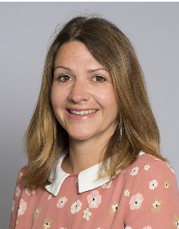
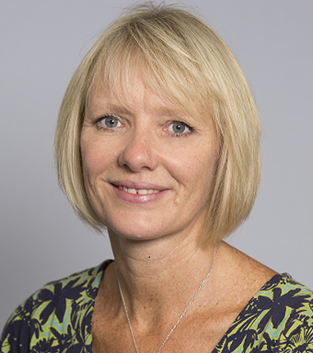
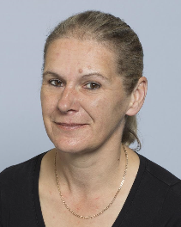
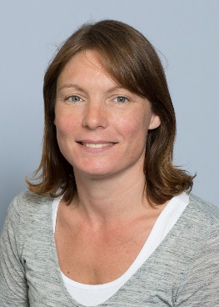
We are:
Mrs Bowman
Mrs Shrimpton
Mrs Wilton
Miss Kernan

Slide 3
5
Independence
It is lovely to see so
many children entering the classroom independently
in the mornings and
they have settled really well.
Collection from
school
Please let the school know
of any changes to the
collection of your child in advance.

Slide 4
Topics
Each week we are choosing a different text based on one of our school values.

Slide 5
Activities
The children are
enjoying completing
a range of activities
both inside and
outside of
the classroom

Slide 6
Classroom
We have a range of rewards,
including stickers –
which they love to receive,
to encourage
children to do
the best that
they can.

Slide 7
Transition
In these early weeks,
we will be focusing
on settling activities
that encourage
self-esteem and
confidence, as well
as helping them to
develop positive relationships with their peers.

Slide 8
Book Changing
For the time being books
will be changed once
a week.
Your child will be told on which day their books
will be changed.

Slide 9
Home/school Diary
Please sign the diary when
you have heard your child
read.
It can also be used to
communicate messages.

Slide 10
Home/school Diary
The smiley faces are for
your child to complete
daily to reflect their day
in school.
Please sign the diary
each week, we will also
sign them weekly on Thursdays in Herons.

Slide 11
High Frequency and Common Exception Words.
Your child will have been given (in their book bag) a list of words. They will be familiar with some of these words from their work in Year 1. Please can your child practise reading these words with your support. When your child becomes confident with reading these words, they can then move on to practise spelling them.

Slide 12
The Library Book Club
Later on this half term, your child will have the opportunity to take a library book home of their choosing. This will happen on a Friday.
Please can they also return their book on a Friday so that they may be issued with a new one.

Slide 13
Homework
Once homework is issued, it will be set fortnightly.
This is a necessary part of your child’s learning as it enables them the opportunity to apply skills taught in a creative, open ended way linked to their personal interests.

Slide 14
Homework
By supporting you child with their homework you are providing them with valuable guidance that will help them to
Complete a piece of work they can be proud of. We are always available to answer any questions you may have.

Slide 15
Homework
We ask that any written
work is recorded in pencil
as they would do in school.
Homework should be
presented with care and
handed in on time.

Slide 16
Spellings
Once spellings have been issued, they will be set on a Friday. They will then be tested the following Friday.
Further information will be given in due course.

Slide 17
P.E.
Thursday
Please ensure your child
has appropriate kit
and correctly fitting
plimsolls or trainers,
all clearly named.
Long hair tied back and
earrings taped or
removed that day.

Slide 18
Medical
Please inform the
school if there are
any medical changes
we might
need to know about.
Also please ensure
we have spare,
in-date epipens/inhalers
at school.

Slide 19
End of the Day
Children will continue
to be collected from
the classroom.
If you are running late,
do let the office know and
also if you have asked
someone else to collect
your child.
Also a polite reminder to
avoid parking on the school campus.

Slide 20
Contact Details
Please inform the
school if your
contact details
change.

Slide 21
Communication
Please look out for
our school newsletter via parentmail/website and our weekly ‘What We Are Learning’ sheet online.
Do check your child’s
book bag and the school website for additional letters and information. Please respond promptly when necessary.

Slide 22
Jumpers and Cardigans!
Please ensure ALL jumpers and cardigans are named.

Slide 23
Water
We encourage all children to come to school with a named water bottle (no juice).
We do offer water with snack before break and upon request.

Slide 24
Holidays
Year 2 is a very
busy year. It is the final
year of Key Stage 1 and
we assess the children
regularly throughout the
year.
Unless there are
exceptional circumstances
please do not take your
child out of school during
term time.

Slide 25
We promise to look
after your child and
we will make time for them
to ask questions.
They can talk to us about
any worries they
may have.

Slide 26
Please do not hesitate
to speak to any of us if you have any queries.
Mrs Spencer is available to speak to any parents concerning any pastoral issues you may have.
You can leave a phone message with the office or email the school office.
Mrs Bowman or Mrs Shrimpton will respond as soon as possible.

Slide 27
Friends Of John Hampden
FoJH do an amazing job planning events to raise additional funds for our school.
They would really value new members to join their team.
Please enquire via the school office for further information.
Thank you!

