Slide 1


Welcome to
The Foundation Stage
September 2023

Slide 2
Our Timetable …
This half term, the children are spending their time settling in to school life, building relationships and making new friends.
After the initial settling in period spent with their own classmates and class teachers, the children will have the opportunity to mix with other classes throughout the day in the octagon and the garden.

Slide 3


Uniform
The children all look very smart in their uniforms, and they are proud to be part of The John Hampden School community.
Please ensure that EVERYTHING has your child’s name in –including their lunchbox (on the outside).
Please show them where it is named so they can check it.
Please send in a coat EVERY DAY.
Sensible shoes and no jewellery.
P.E. Days are every Wednesday with Premier Sports
PE sessions; children will only take their shoes and socks off for the first couple of weeks.
Children active for most of the day.

Slide 4
Autumn Half Term
Learning Adventure - Magical Me!
Learning about The John Hampden Values and Expectations through stories and activities
Harvest Celebration – Wednesday 27th September at 9.30am (details to follow)
Weekly ‘What we are learning’ Communication sheets to inform you about our learning for the week.
Government baseline assessment

Slide 5
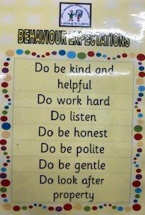
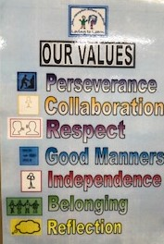
Expectations…
The John Hampden Behaviour Expectations
Do be kind and helpful
Do work hard
Do listen
Do be honest
Do be polite
Do be gentle
Do look after property
School Values

Slide 6

Recognising Achievements
Scroll of Honour
‘Over and Above’ recognition assembly
‘Loving To Learn’ board,
Recognition Board
Stickers.
‘WOW’ moments
Class specific incentives

Slide 7
Independence
Please continue to encourage your children to independently practice;
going to the toilet and wiping their bottom independently
getting dressed and undressed; jumpers & cardigans, shirt and coat buttons & zips, shoes and socks.
recognising their own name and initial sound.
pouring water and drinking from an open top
using a knife and fork in readiness for hot school dinners.

Slide 8
Other matters…
Please ensure that your child brings in their book bag every day.
Home school diary – useful communication. Please sign every week. Please sign when your child has read their book with you.
Outside equipment and resources – Please do not let your children play on the equipment or with resources set up at the start or end of the day.
Going home – permission.
Wish List – We may sometimes ask for donations of items that you may have at home. E.g. Left-over Christmas cards/wrapping paper, straws, tissues, cups.

Slide 9
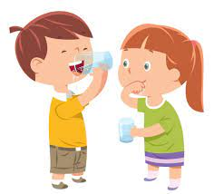
Other matters…
Allergens
Nut free school
First Aiders
Head bumps
Water available through out
the day – no need for water bottles

Slide 10
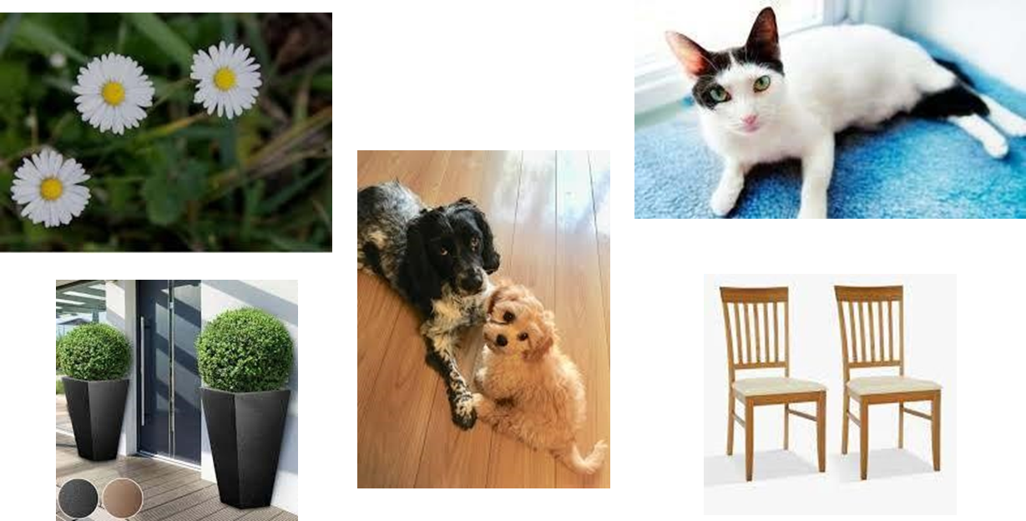
What can you do to help your child’s mathematical development???
Subitising. We need to give children opportunities to see and name whole amounts without counting.

Slide 11
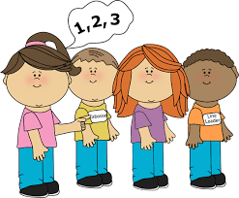
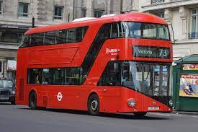
What can you do to help your child’s mathematical development???
Counting Rhymes & songs
Number recognition
Naming colours and patterns
Weighing and measuring.
Maths in the ‘environment’
Cooking

Slide 12
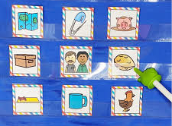
Phonics
The ability to read has truly become a necessity to survive and thrive in today’s society. Phonics is the most successful way to teach reading.
During the Autumn term we focus on teaching 4 key areas of Phonics;
Oral blending
Sound recognition
Blending
Tricky words

Slide 13



Oral Blending
This is the most important skill of all. If children can orally blend they will be successful.
If we say c-a-t children need to be able to hear cat.
If we say d-o-g, children need to be able to hear dog.
It is a skill that is learnt with practice and repetition. You can help by reinforcing this at home, making it into a guessing game or even putting it into context – go and brush your t-ee-th or put on your c-oa-t.

Slide 14

Sound recognition
We teach the children the sound that the letter makes, not the letter name.
At this stage we do not even say the name of the letter as that is confusing.
We need to be careful that we teach the correct pronunciation – no schwaring!!!
jump

Slide 15

Blending
When children can orally blend and can recognise the sounds instantly, they are ready to read words.
They need to say the sounds together to make a word.
Again, children need lots of practice.
E.g. It is a pen.

Slide 16
Tricky Words
There are, of course, words in the English language that you cannot sound out. These are called tricky words and need to be learnt by memory.
Examples of tricky words are:
I to the no go into

Slide 17

Phonics
Once the children have settled in, we will begin sending home a phonics activity once a week. Last week, we sent home a weekly phonics sound strip. You will need to practise these activities daily with your children to help them embed what they have learnt in school.
Little and often is most helpful.
Any questions about Phonics?

Slide 18


Books
From Friday 15th of September, the children have been provided with wordless reading books.
Further information was also sent home.
These books are initially wordless to help teach all children the necessary pre reading skills.

Slide 19

Library Club
Each week the children will be given the opportunity to select a book during Library Club.
They will be able to take this book home on a Friday to share with you to nurture their love of reading.
The following Friday their ‘Library Club’ book will need to be returned, so that they can replace it with another book of interest.
Any questions?

Slide 20
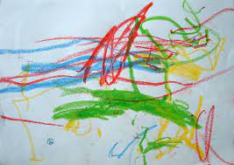
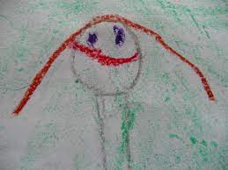
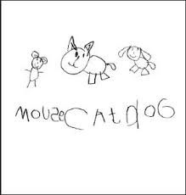
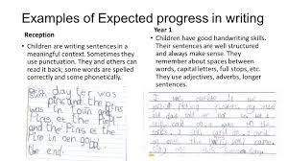

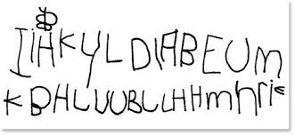
Writing
Drawing
Pre-writing patterns
Writing names
Encouraging mark making/ scrimbling – often for a purpose

Slide 21

Workshops
Throughout the year we will invite you into school or provide online information or links for Phonics, Maths and Writing Workshops. Details will follow.
Partnership with Parents

Slide 22
And Finally…
If you have any worries or concerns, please come in and see us and we will always do our best to help you.
We look forward to working with you and your child throughout the school year.
The Foundation Stage Team ☺

