Slide 1
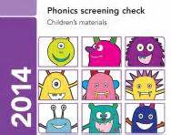
Y1 Phonics Screening Check
General Information about the Screening Check.
The purpose of the check.
How it is administered
How you can support your child

Slide 2
What is the Phonics Screening Check?
The government introduced the Phonics Screening Check to all schools in June 2012.
All children in Year 1 take the test in June.
WC 12th June 2023
Provides information for teachers and parents on how each child is progressing in phonics.

Slide 3
What is the purpose of the check?
Helps to identify whether a child needs additional support at this stage so that they do not fall behind in this vital early reading skill.

Slide 4
What does it check?
It will check how well a child can:
Sound out and blend graphemes in order to read simple words.
Read phonically de-codable one-syllable and two-syllable words.

Slide 5
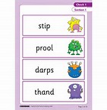
How is the check structured?
40 words – 4 words per page
Real and pseudo words (‘alien’ words)
‘Alien’ words have pictures to make clear they are not real words.
Words become progressively more challenging.

Slide 6
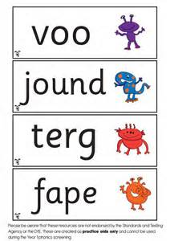
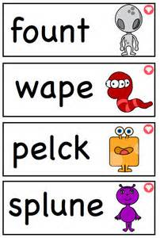

Slide 7
Why ‘alien’ words?
The purpose of the alien words is to check the child’s ability to use their phonic knowledge to decode.
The words are made up of graphemes that they will have learnt.
They can’t be guessed!

Slide 8
How is the check administered?
Class teacher – familiarity for children
Quiet place- 1:1
Takes around 5 to 10 minutes per child but no time limit
Strict guidelines for teachers on how to administer the test to ensure consistency.

Slide 9
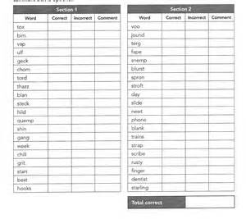
How is it marked?
The child is given 1 mark for each word that is correctly decoded.
The check is marked whilst it is being administered.
Can be externally moderated to ensure guidelines are followed.
A ‘pass’ mark is set by the Department for Education. It is usually around 32.

Slide 10
What happens next?
If a child does not meet the pass mark they are required to re-take the screening check in Year 2.
The data is passed on to the Year 2 teachers so that they can plan any additional support that may be required.

Slide 11
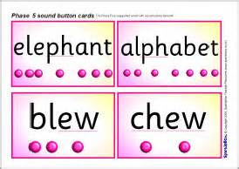
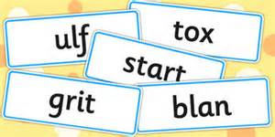
How can you support your child?
Keep practising the phonic sounds.
Encourage your child to segment and blend new words when reading.
Work on the words recently sent home in a pack to build confidence.
Have fun making up ‘alien’ words that your child can segment and blend.

