Slide 1


Welcome to
The Foundation Stage
September 2024

Slide 2
Our Timetable …
This half term, the children are spending their time settling in to school life, building relationships and making new friends.
After the initial settling in period spent with their own classmates and class teachers, the children will have the opportunity to mix with other classes throughout the day in the octagon and the garden.

Slide 3
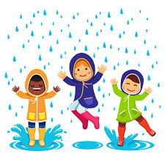

Uniform
The children all look very smart in their uniforms, and they are proud to be part of The John Hampden School community.
Please ensure that EVERYTHING has your child’s name in –including their lunchbox (on the outside).
Please show them where it is named so they can check it.
Please send in a coat EVERY DAY.
Sensible shoes and no jewellery.
P.E. Days are every Friday with Premier Sports
PE sessions; the children will be changing for PE, so regular practise at home will help them to develop their confidence and ensure success.
The children are active for most of the day.

Slide 4
Autumn Half Term
Learning Adventure - Magical Me!
Learning about The John Hampden Values and Expectations through stories and activities
Harvest Celebration – Thursday 26th September at 9.00 am in the school hall. Please drop your children off as usual and make your way to the school hall via the car park.
Weekly ‘What we are learning’ Communication sheets to inform you about our learning for the week.
Government Baseline Assessment

Slide 5
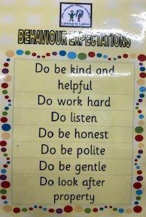
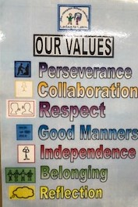
Expectations…
The John Hampden Behaviour Expectations
Do be kind and helpful
Do work hard
Do listen
Do be honest
Do be polite
Do be gentle
Do look after property
School Values

Slide 6

Recognising Achievements
Scroll of Honour
‘Over and Above’ recognition assembly
‘Loving To Learn’ board,
Recognition Board
Stickers.
‘WOW’ moments
Class specific incentives

Slide 7
Independence
Please continue to encourage your children to independently practise;
going to the toilet and wiping their bottom independently
getting dressed and undressed; jumpers & cardigans, shirt and coat buttons & zips, shoes and socks.
recognising their own name and initial sound.
pouring water and drinking from an open top
using a knife and fork for hot school dinners.

Slide 8
Other matters…
Please ensure that your child brings in their book bag every day.
Home school diary – useful communication. Please sign every week. Please sign when your child has read their book with you.
Outside equipment and resources – Please do not let your children play on the equipment or with resources set up at the start or end of the day.
Going home – permission.
Wish List – We may sometimes ask for donations of items that you may have at home. E.g. Left-over Christmas cards/wrapping paper, straws, tissues, cups.

Slide 9
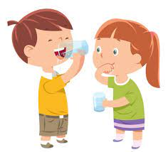
Other matters…
Allergens
Nut free school
First Aiders
Head bumps
Water available throughout
the day – no need for water bottles

Slide 10


Books
Soon the children will be provided with wordless reading books. Wordless reading books help children to learn the necessary pre-reading skills.
When the children are able to successfully blend, they will receive a reading book or card.
Further information will follow soon.

Slide 11

Library Book Club
Each week the children will be given the opportunity to select a book during Library Book Club.
They will be able to take this book home on a Friday to share with you to nurture their love of reading.
The following Friday their ‘Library Book Club’ book will need to be returned, so that they can replace it with another book of interest.
Any questions?

Slide 12
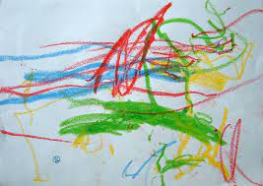
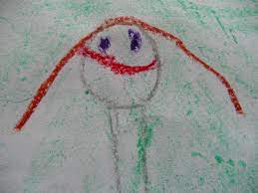
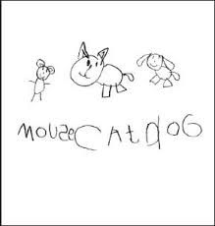
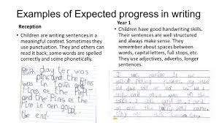

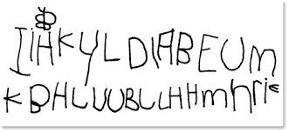
Writing
Drawing
Pre-writing patterns
Writing names
Encouraging mark making for a purpose

Slide 13

Workshops
Throughout the year we will invite you into school or provide online information or links for Phonics, Maths and Writing Workshops. Details will follow.
Partnership with Parents

Slide 14
And Finally…
If you have any worries or concerns, please come in and see us and we will always do our best to help you.
We look forward to working with you and your child throughout the school year.
The Foundation Stage Team ☺

