Slide 1
Welcome to the
Firecrests
Class

Slide 2
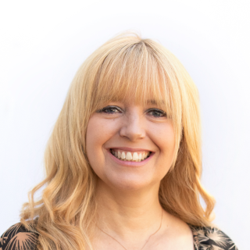
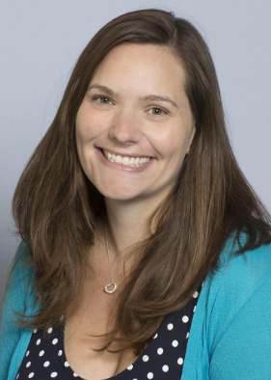
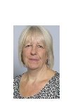
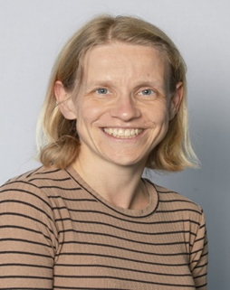
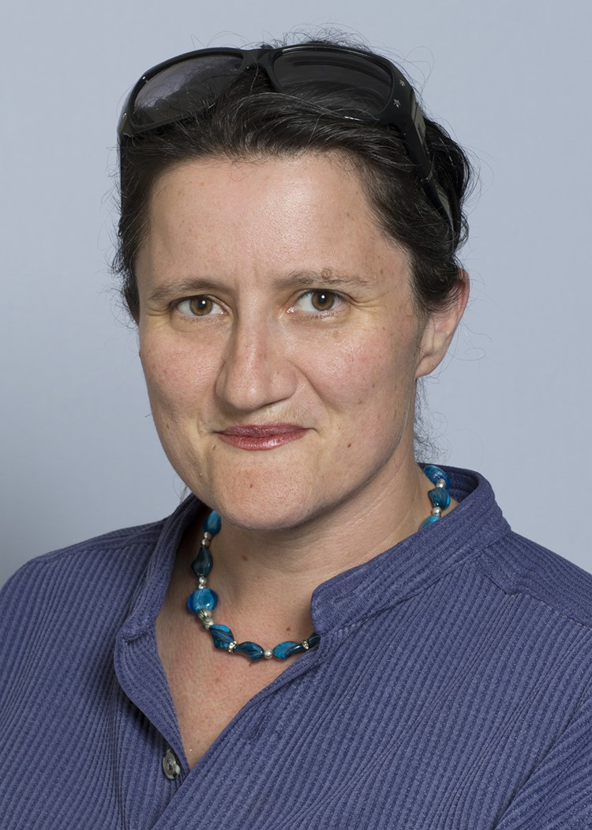
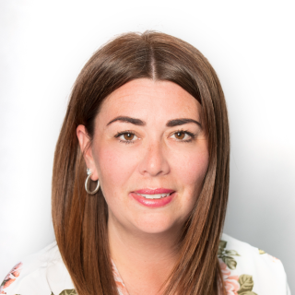
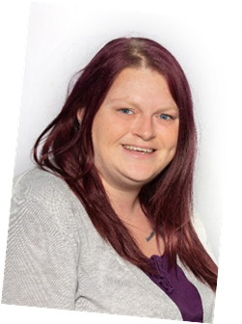
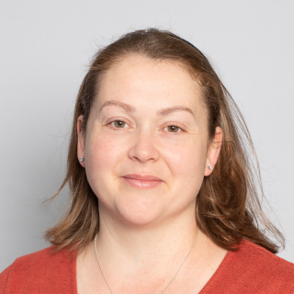
We are:
Mrs McNally
Mrs Mannering
Mrs King
Mrs Gooch
Miss Smith
Mrs McMullan
Mrs Quigley
Mrs Wisson

Slide 3
5
Independence
It is lovely to see so
many children entering the classroom independently
in the mornings and
they have settled really well.
Collection from
school
Please let the school know
of any changes to the
collection of your child in advance.

Slide 4
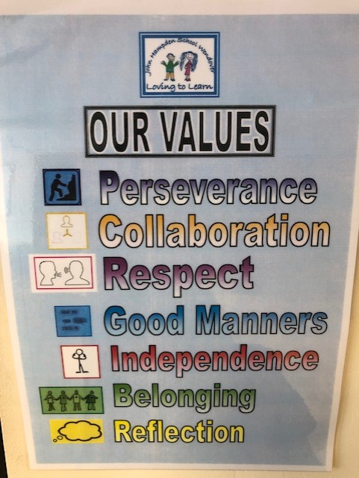
Topics
Each week we are choosing a different text based on one of our school values.

Slide 5
Activities
The children are
enjoying completing
a range of activities
both inside and
outside of
the classroom

Slide 6
Classroom
We have a range of rewards,
including stickers – which they love to receive,
to encourage
children to do
the best that
they can.

Slide 7
Transition
In these early weeks,
we will be focusing
on settling activities
that encourage
self-esteem and
confidence, as well
as helping them to
develop positive relationships with their peers.

Slide 8
Book Changing
For the time being books
will be changed once
a week.
Your child will be told on which day their books
will be changed.

Slide 9
Home/school Diary
Please sign the diary when
you have heard your child
read their books.
It can also be used to
communicate messages.

Slide 10
Home/school Diary
The smiley faces are for
your child to complete
daily to reflect their day
in school.
Please sign the diary
each week, we will also
sign them weekly (on Thursday or Friday).

Slide 11
High Frequency Words & Tricky Words
On Friday your child will have been given, in their book bag, a list of High Frequency and Tricky Words.
They will be familiar with many of these words from year 1. Please can your child practise reading these words at home, with your support.
When your child becomes confident in reading the words they can then move on to practise spelling them.

Slide 12
Library Book Club
Friday afternoon.
Children will take a book home to read. They need to bring it back the next Friday. Children will share feedback and recommend books and swap them.

Slide 13
Homework
Once homework is issued, it will be set fortnightly.
This is a necessary part of your child’s learning as it enables them the opportunity to apply skills taught in a creative, open ended way, linked to their personal interests.

Slide 14
Homework
By supporting your child with their homework, you are providing them with valuable guidance that will help them to complete a piece of work they can be proud of.
We are always available to answer any questions you may have.

Slide 15
Homework
We ask that any written work is recorded in pencil as they would do in school.
Homework should be presented with care and handed in on time.

Slide 16
Spellings
Once spellings have been issued they will be set on a Friday. They will then be tested the following Friday. These are linked to Supersonic Phonics.
Further information will be given in due course.

Slide 17
P.E.
Thursday
Please ensure your child
has appropriate kit
and correctly fitting
plimsolls or trainers,
all clearly named.
Long hair tied back and
earrings taped or
removed that day.

Slide 18
Medical
Please inform the
school if there are
any medical changes
we might
need to know about.
Also please ensure
we have spare,
in-date epipens/inhalers
at school.

Slide 19
Allergies
A reminder about packed lunches. Please can we remind parents that there should be no nuts, no sesame or chocolate in lunchboxes.
We have children in our class that have nut and sesame allergies and will require an epipen.

Slide 20
End of the Day
Children will continue
to be collected from
the classroom.
If you are running late,
do let the office know
if you have asked someone
else to collect
your child.

Slide 21
Contact Details
Please inform the
school if your
contact details
change.

Slide 22
Communication
Please look out for
our school newsletter and our weekly ‘What We Are Learning’ sheet via ParentMail / Website.
Do check your child’s
book bag and the school website for additional letters and information. Please respond promptly when necessary.

Slide 23
Jumpers / Cardigans & PE Kit
Please ensure ALL jumpers, cardigans and all PE Kits are named.

Slide 24
Water
We encourage all children to come to school with their own named water bottle containing water, for drinking through the day.
We do offer water with snack before break time and on request.

Slide 25
Holidays
Year 2 is a very
busy year. It is the final
year of Key Stage 1 and
we assess the children
regularly throughout the
Year, with a particular focus in May.
Unless there are
exceptional circumstances
please do not take your
child out of school during
term time.

Slide 26
We will always make time for your children
to ask questions.
They can talk to us about
any worries they
may have.

Slide 27
Please do not hesitate
to speak to any of us if you have any queries.
Mrs Spencer is available to speak to any parents concerning any pastoral issues you may have.
You can leave a phone message with the office or email the school office.
Mrs McNally or Mrs Mannering will respond as soon as possible.

Slide 28
Friends of John Hampden School
FJHS do an amazing job planning events to raise additional funds for our school.
They would really value new members to join their team.
Please enquire via the school office for further information.
Thank you!

Slide 29
Thank you!

