Slide 1
Welcome
Assessment at the end of Key Stage One
Non-statutory

Slide 2
Assessment at the end of Key Stage One
When did KS1 statutory assessment start?
Why has it become non-statutory?
What/who are we doing assessment for?
What is tested under this system?
How is it tested?
How is it marked?
What will children know about it?
What will parents know about it?
When will it all happen?
How can you help?
QUESTIONS

Slide 3
History of this assessment process?
A revised National Curriculum was introduced in September 2014 (more challenging, more demanding)
2024 –first time the assessments for the end of Year 2 were non-statutory (process cancelled in 2020 and 2021)

Slide 4
What / who are we doing it for?
ascertain what pupils have achieved in relation to the areas of the national curriculum
JHSW Accountability for the attainment and progress made by pupils
inform parents and schools(?) about the performance of individual pupils
enable benchmarking between schools, as well as monitoring performance locally and nationally(?)

Slide 5
What is tested under the system?
ENGLISH
Reading
Spelling, Grammar, punctuation
MATHS
ENGLISH
Speaking & Listening BUT….
Writing BUT……
SCIENCE BUT…..

Slide 6
How is it tested?
Test papers

Slide 7
READING

Slide 10
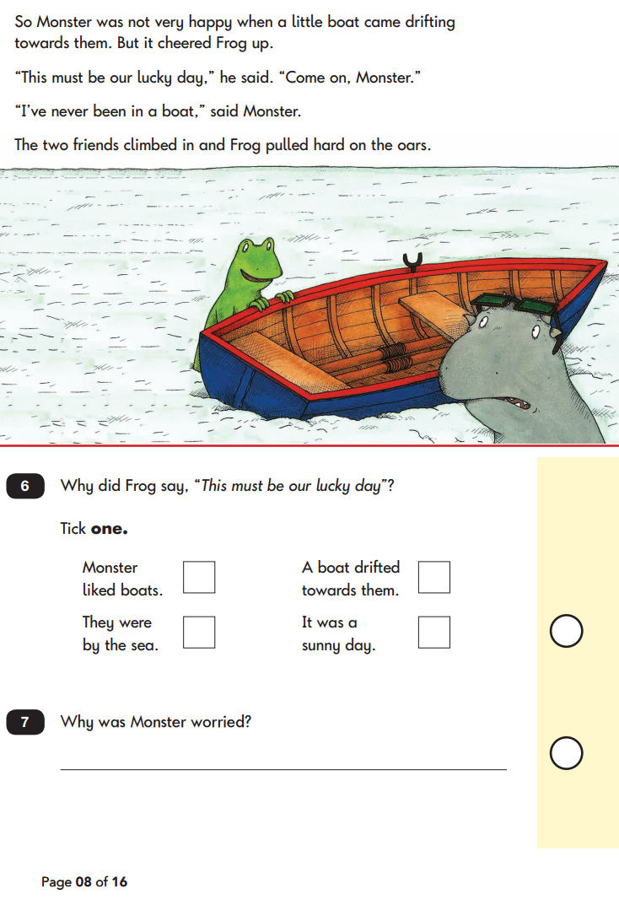

Slide 11
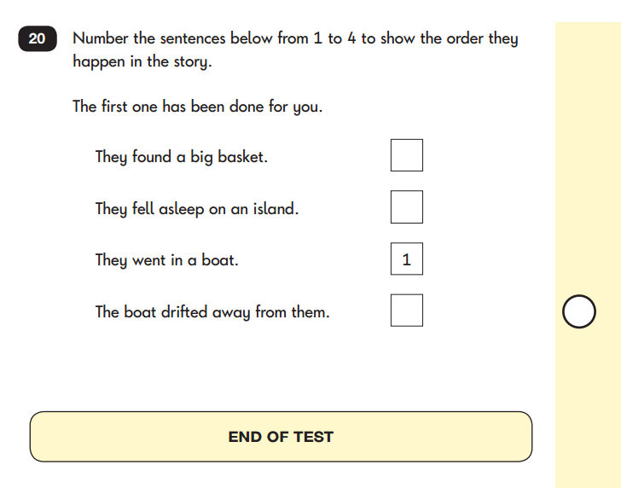

Slide 13
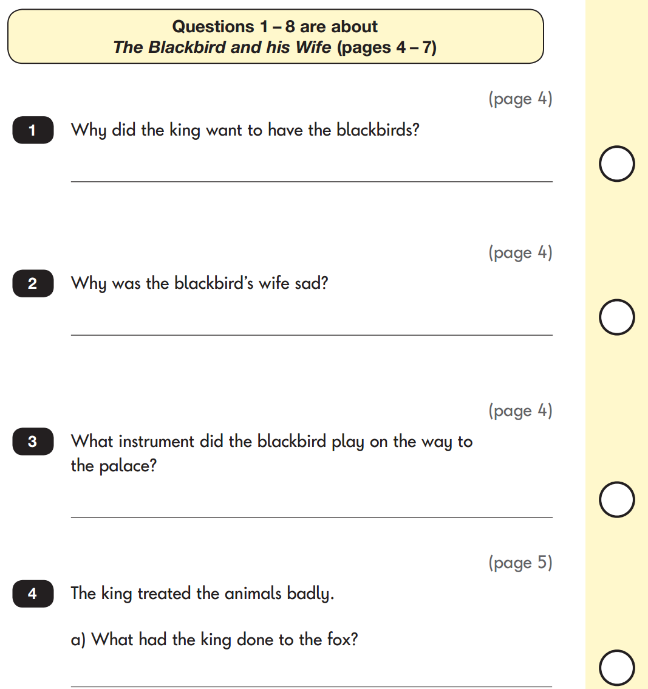

Slide 14
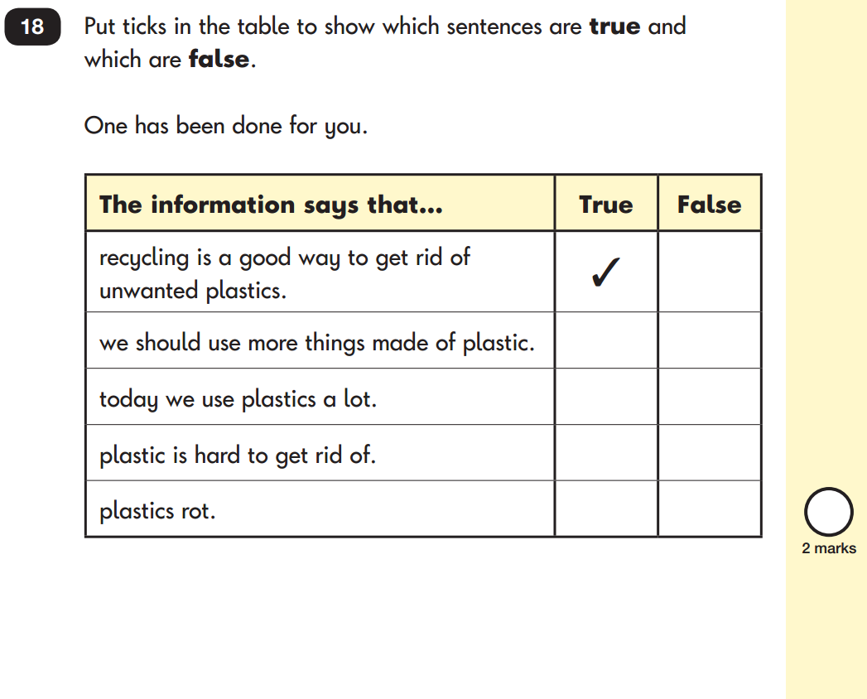

Slide 15
SPELLING, GRAMMAR & PUNCTUATION

Slide 17
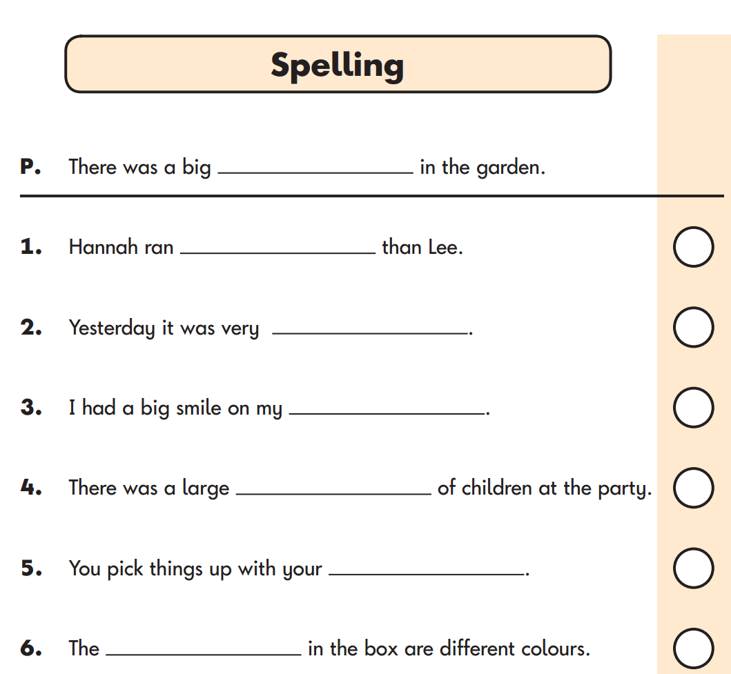

Slide 18
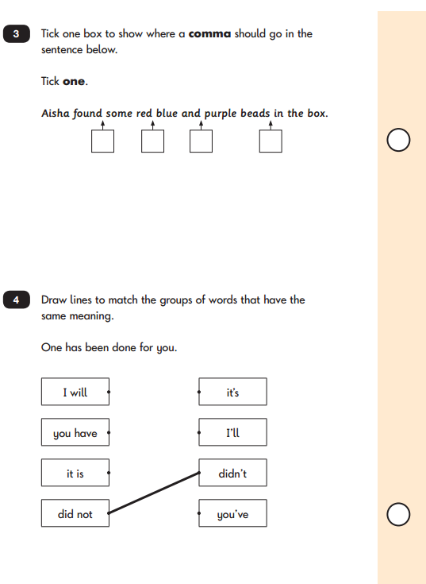

Slide 19
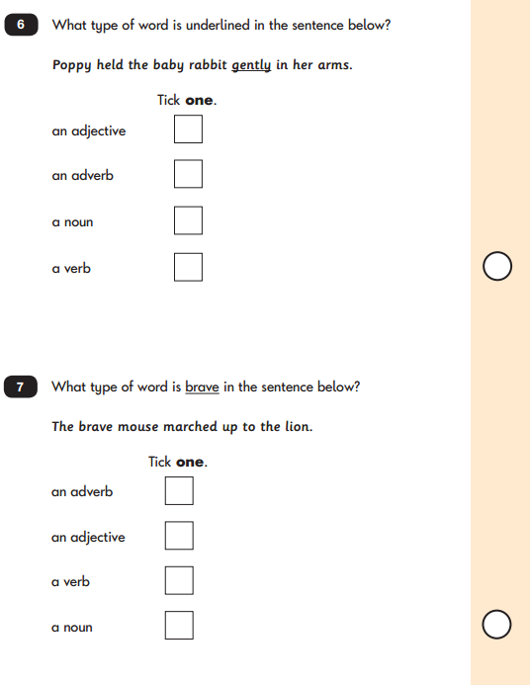

Slide 20
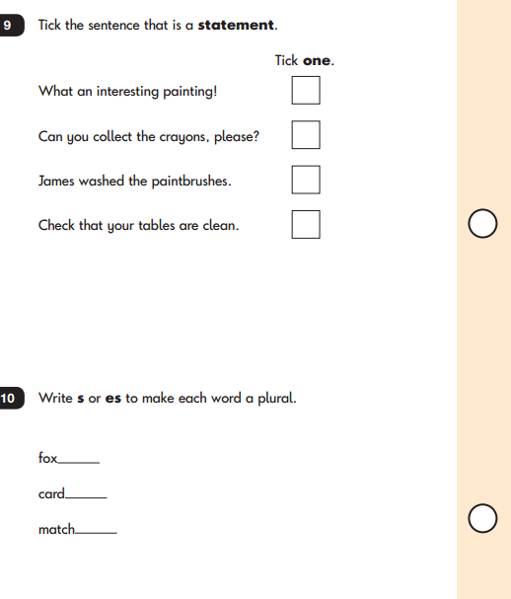

Slide 21
MATHS

Slide 23
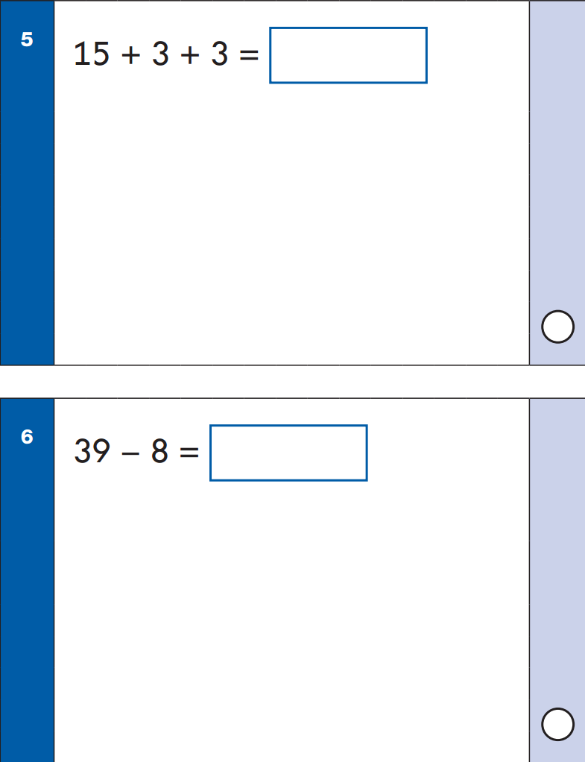

Slide 24
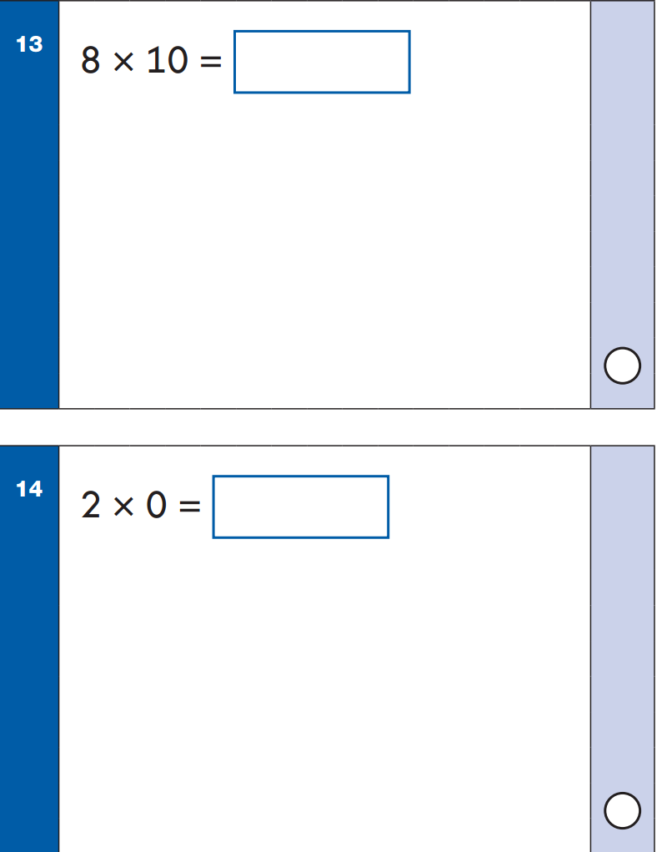

Slide 25
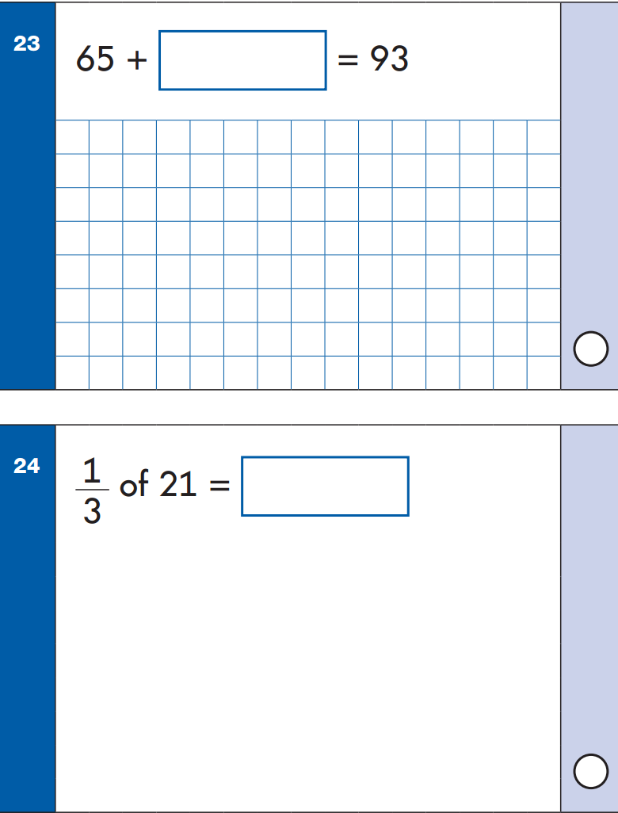

Slide 26
MATHS – Mathematical Reasoning

Slide 27
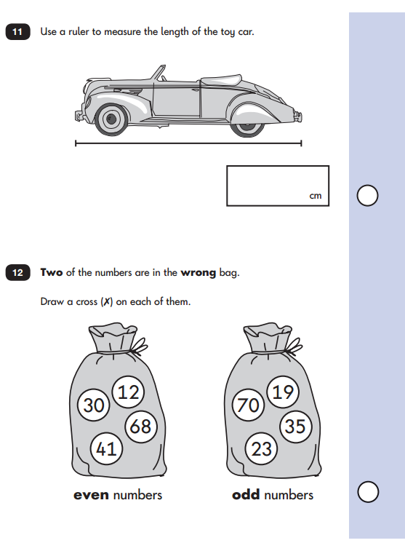

Slide 28
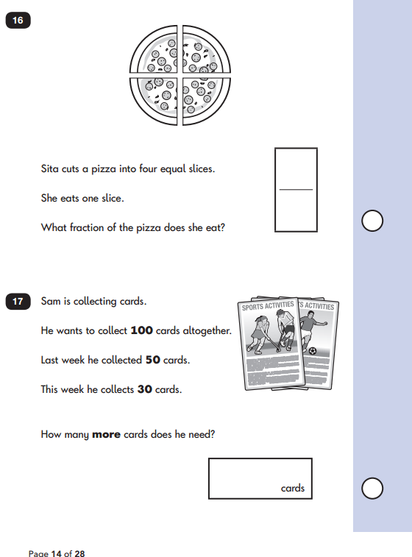

Slide 29
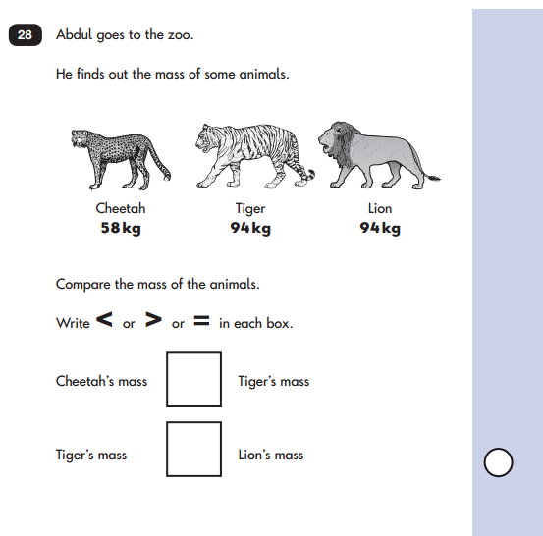
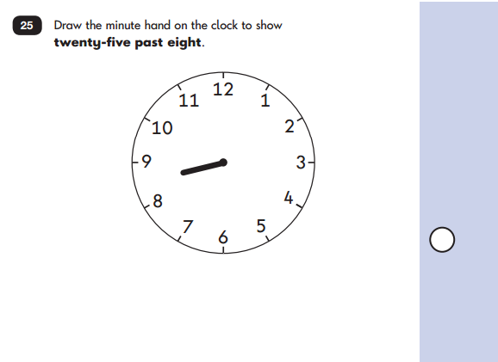

Slide 30
Pupils working at the expected standard will be able to engage with all questions within the tests. However, they will not always achieve full marks on each question, particularly if working at the threshold of the expected standard.

Slide 31
What will the children know about it?
What we tell them!!
Expectations
Please note:
schools to ensure that pupils are given sufficient time to demonstrate what they understand, know and can do without prolonging the test inappropriately.
The tests are designed to enable pupils to demonstrate their attainment and as a result are not strictly timed since the ability to work at pace is not part of the assessment

Slide 32
How is it marked?
Marked by teachers using a mark scheme
The raw score on the test (the total marks achieved out of the marks available) will be converted into a scaled score using a conversion table. Translating raw scores into scaled scores ensures performance can be reported on a consistent scale for all pupils
Each pupil will receive an overall result indicating whether or not he or she has achieved the required standard on the test. A standard-setting exercise will be conducted to determine the scaled score needed for a pupil to be considered to have met the standard
Moderation

Slide 33
What will parents know about it?
What we tell you!!
What the children tell you
Media?
Teacher Assessment at the end of the year – Annual Report
Working towards the expected standard
Working at the expected standard
Working at greater depth within the expected standard

Slide 34
When will it all happen?
Timetable – May

Slide 35
How can you help?
Attendance
Stay calm!
Guidance from school
Website

Slide 36
QUESTIONS

