Slide 1

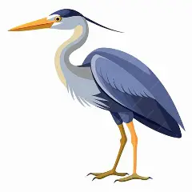
Welcome to
Herons

Slide 2
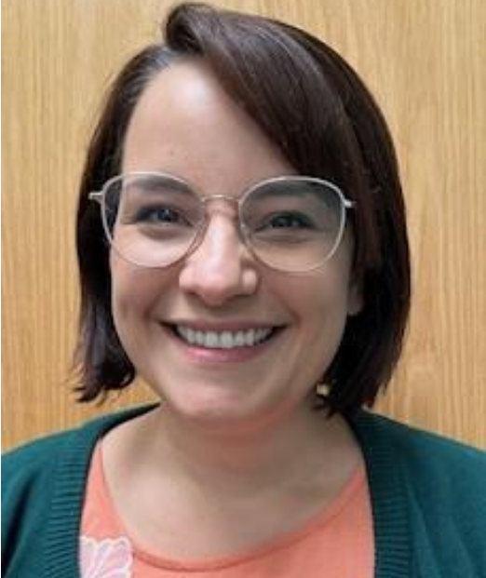
The Class Teacher is:
Mrs Lemming
Monday - Thursday

Slide 3
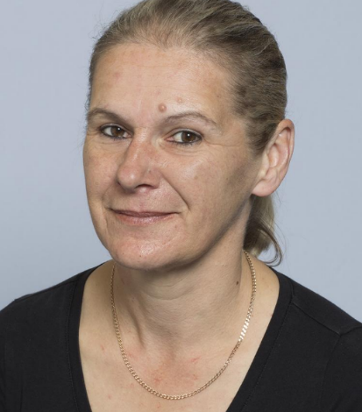
The Teaching Assistants are:
Mrs Wilton

Slide 4
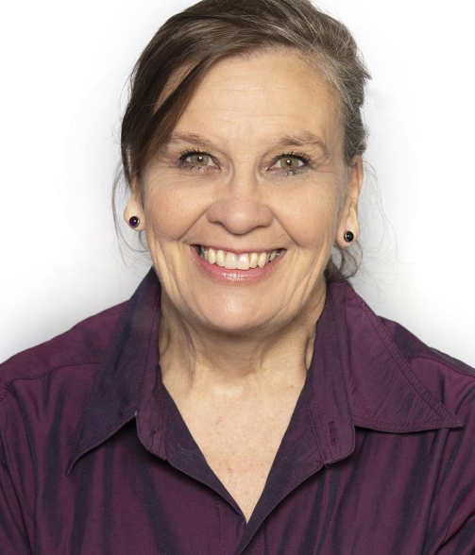
MDMS
Mrs Symthe

Slide 5
5
Independence
It is lovely to see so
many children entering the
classroom independently
in the mornings.
The children have settled well.
Collection from
school
Please let the school know
of any changes to the
collection of your child in advance.

Slide 6
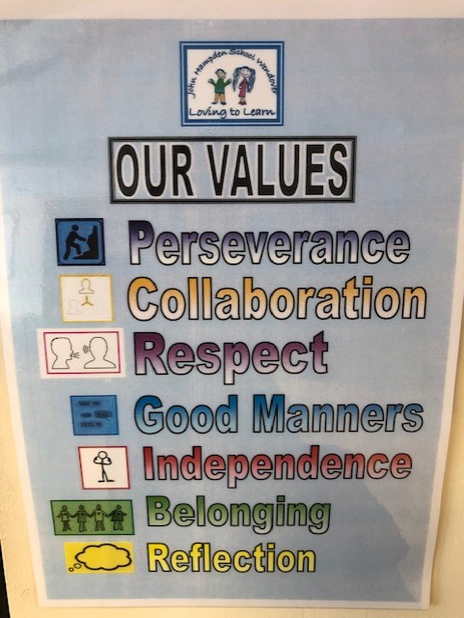
Topics
This term we are choosing a different text each week based on one of our school values.

Slide 7
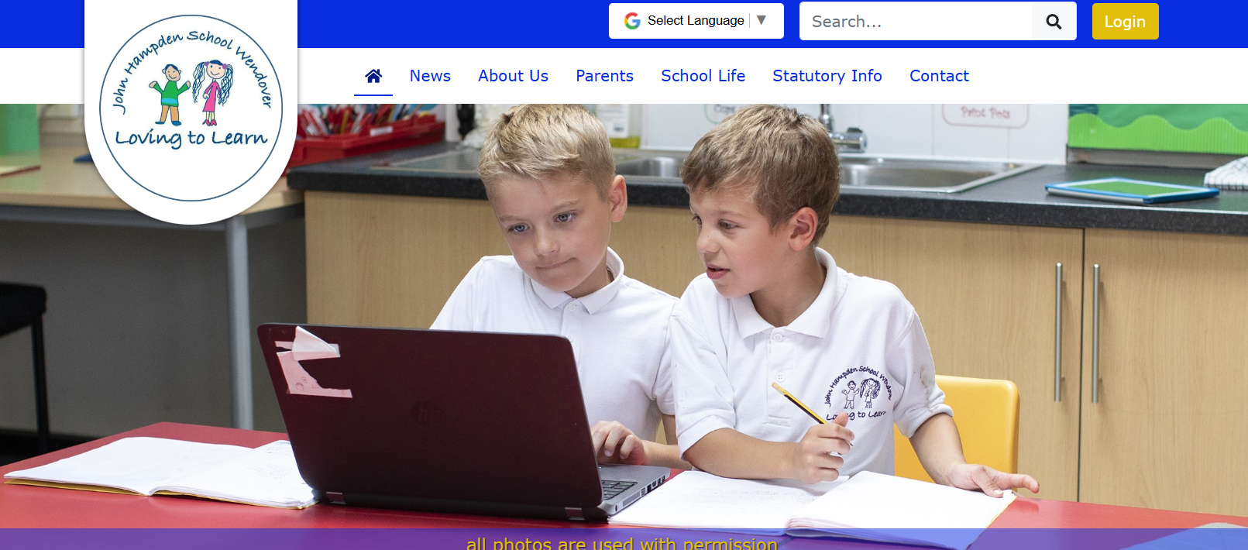
Website
What we are learning will be on our class page on the website.

Slide 8
Upcoming fun
in Year 2!
We have a range of
exciting topics, trips and special days planned throughout the year.
We will provide more information about these shortly and will ensure the costs are spread evenly throughout the year through voluntary contributions.

Slide 9
Classroom Rewards
We have a range of rewards,
including the recognition board, stickers, gems
for their table jars and the Head Teacher’s award.
These encourage children
to do the best that they can.
Every week a child is selected for an Over and Above award based on our school values.

Slide 10
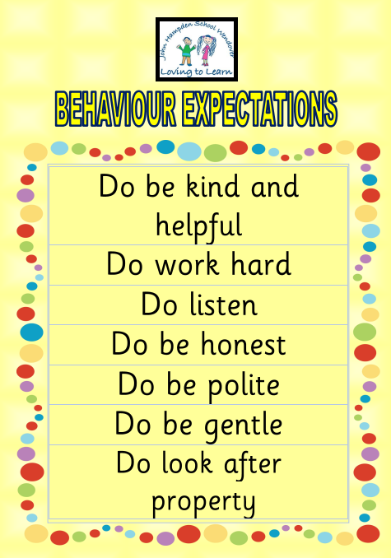


Slide 11
Transition
In these early weeks,
we will be focusing
on settling activities
that encourage
self-esteem and
confidence, as well
as helping the children to develop positive relationships with their peers.

Slide 12
Book Changing
Books are changed once a week. We will hear your child read on this day.
Children will also participate in a Guided Reading group with a TA once a week

Slide 13
Home/School Diary
Please sign the diary when
you have heard your child
read their books. This should be signed every week and we will also sign it.
It can also be used to
communicate messages.
There is a new design this year which should last all year. Please look after it!

Slide 14
High Frequency Words & Tricky Words
On Friday your child will be given a list of High Frequency and Tricky Words.
They will be familiar with many of these words from Year 1. Please can your child practise reading these words at home, with your support.
When your child becomes confident reading the words, they can then practise spelling them.

Slide 15
Library Book Club
On a Friday afternoon, the children will take a book home to read. They need to bring it back the next Friday. Children will share feedback and recommend books and swap them.

Slide 16
Homework
Once homework is issued, it will be set fortnightly.
This is a necessary part of your child’s learning as it enables them the opportunity to apply skills taught in a creative, open ended way, linked to their personal interests.

Slide 17
Homework
By supporting your child with their homework, you are providing them with valuable guidance that will help them to complete a piece of work that they can be proud of.
We are always available to answer any questions you may have.

Slide 18
Homework
We ask that any written work is recorded in pencil as they would do in school.
Homework should be presented with care and handed in on time.

Slide 19
P.E.
Friday
Please come to school in PE kit on this day.
Long hair should be tied back and earrings taped or
removed that day.

Slide 20
Medical
Please inform the
school if there are
any medical changes
we might
need to know about.
Also please ensure
we have spare,
in-date epipens/inhalers
at school.

Slide 21
Allergies
Please can we remind parents that there should be no nuts, no sesame or chocolate in lunchboxes.
We have children in our school that have nut and sesame allergies and will require an epipen.

Slide 22
End of the Day
If you are running late,
do let the office know if
you have asked someone
else to collect
your child.

Slide 23
Contact Details
Please inform the
school if your
contact details
change.

Slide 24
Communication
Please look out for
our school newsletter and our weekly ‘What We Are Learning’ sheet via ParentMail / Website.
Do check your child’s
book bag and the school website for additional letters and information. Please respond promptly when necessary.

Slide 25

Jumpers / Cardigans & PE Kit
Please ensure ALL jumpers, cardigans and all PE Kits are named.

Slide 26
Water
We encourage all children to come to school with their own named water bottle containing water, for drinking through the day.
We do offer water with snack before break time and on request.

Slide 27
Holidays
Year 2 is a very
busy year. It is the final
year of Key Stage 1 and
we assess the children
regularly throughout the
Year, with a particular focus in May/June.
Unless there are
exceptional circumstances
please do not take your
child out of school during
term time.

Slide 28
We will always make time for your children
to ask questions.
They can talk to us about
any worries they
may have.

Slide 29
Please do not hesitate
to speak to any of us if you have any queries or you can leave a phone message with the office or email the school office.
I will respond as soon as possible.

Slide 30
Friends of John Hampden School
FJHS do an amazing job planning events to raise additional funds for our school.
They would really value new members to join their team.
Please enquire via the school office for further information.
Thank you!

Slide 31
And Finally…
We hope to make your child’s year at John Hampden a memorable and happy one.
Any questions?

Slide 32
Thank you!

