Slide 1
Transition – How can I help my child?
The prospect of moving on to a new school or a new class can be a worrying time for children as well as parents. It is normal for children to feel a mixture of excitement and anxiety before the start of term, most will settle down quite happily during the first few days but others may need a little longer.

Slide 2
What do the children think about moving on?
We asked the children to tell us what they thought, here are some of their quotes.
‘I feel nervous & excited’
‘A bit shy’
‘Sad & happy at the same time’
‘A bit scared’
‘Excited about which new teacher I might be with’
‘Excited….new adventure, new people to meet’
‘Sad to end my time at John Hampden, I’ll miss my teachers (Year 2)
‘I’m excited to move into Year 2’ 2 as lots of new things to learn’

Slide 3
Transition – How can I help my child?
Here are some suggestions about how to prepare your child for starting school or a new class.

Slide 4
Helping your child to prepare for change
Children may not realise it but they make many transitions every day e.g. from home to town, play activities to a meal or a visit to friends or family.
Remind them of this fact, it will encourage them to know that they already have many of the skills necessary to help them cope with something new.

Slide 5
Helping your child to prepare for change
Be calm and positive about them starting school and enjoy your child’s excitement even if you are anxious about it yourself – children pick up on their parent’s feelings very easily and it may lead them to feel worried themselves.

Slide 6
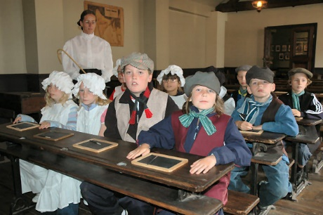
Helping your child to prepare
for change
Remember that children are adaptable and resilient. Sometimes, what seems important to them one minute is forgotten about in the next and there may be certain things that worry you but not your child. Our feelings as adults might possibly be based on own experiences of school as a child.

Slide 7
A listening ear
Be prepared to listen and chat about the changes ahead, your child may prefer to do this while you are both busy doing a creative activity – side by side rather than an ‘interview’ style situation.

Slide 8
A listening ear
Do acknowledge any feelings your child may have even if they don’t mirror your own.
Try saying, 'it’s only natural to feel nervous' rather than 'don’t be silly, there’s nothing to worry about’.
These feelings are normal, offer reassurance by telling them that others may share the same feelings and that together you can overcome them.

Slide 9
A listening ear
Your child will choose to ask you questions about starting school or joining a new class at a time that suits them.
These questions are important but if you aren’t able to answer them at the time, allow for another opportunity to sit with them to talk about what they have asked you.

Slide 10
A listening ear
Once they start school, they may not be prepared to answer questions that you ask about their day, straight away.
It may be last thing at night that they choose to chat about events.

Slide 11
In the holidays
During the holidays, talk though what will happen when your child goes to school. Talk about the journey (a practise run for new starters is a good way to assist with familiarisation).
Talk through the timetable of activities for the first few days available on the school website, it will familiarise your child with events happening during their first few days at school.

Slide 12
In the holidays
Provide your child with opportunities to experience change during the holidays by trying out new activities and visiting different places.
Tell them ahead of time where they are going and what will be happening so that they can mentally prepare.
This should help to minimise challenging behaviour from your child because they should feel more in control of the upcoming situation.

Slide 13
In the holidays
Arrange play-dates with other families whose children will be going to the same school or class as your child.

Slide 14
In the holidays
Visit your local library and read books with your child about starting school and share stories that have the theme of change. Littleparchutes.com is one possible website that suggests book titles linked to different themes.

Slide 15
Encourage independence
Teach your child the importance of being responsible for his or her own belongings.
Tidying up after themselves, doing up buttons & zips etc will help them to manage more independently at school.
Learning how to use cutlery, opening the lid on a water bottle or a lunchbox will help them enormously during lunchtime at school. Trying tasks on their own will also make them feel good about themselves.
‘I can do it!’

Slide 16
Help is at hand
Visit the school website and show your child photos of the key people who will be working with him or her at school.
Why not take your child on the ‘virtual tour’ of the school so that it remains familiar to them through the holidays.

Slide 17
Help is at hand
Do seek advice from your child’s teacher should you wish to, no query is ever too small and we are here to help.
Mrs Barnes or Mrs Parkinson will happily meet with you should you have a serious concern.
Jo Spencer (teacher & pastoral support) is also available to speak to parents who have concerns about transition and to those who anticipate that their child might suffer from separation anxiety.

Slide 18
Help is at hand
Open Evening – this is a wonderful opportunity for you and your child to look around the school, to visit current teachers and to say hello to new ones.

Slide 19
Organisation
Read the school prospectus to gain understanding about how the school is run.
Look at the school website, read through useful items under the ‘key information’ section and familiarise yourself with the most recent newsletter, these will help you to have a better understanding about life at John Hampden school.
Look on your child’s class page to view their timetable and read the termly topic planner to find out about what they will be learning.
Take note of key events coming up in the ‘calendar’ section; you will be able to share upcoming events with your child before they are due to take place.

Slide 20
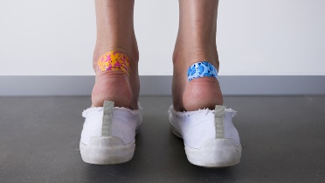
Organisation
Have uniform, book bag, PE kit and shoes ready and named ahead of the first day at school (new starters may even like to try it on and wear it a few times, this will help them to feel comfortable about wearing their school clothes, this should also aid familiarity).
Wearing in new shoes is always a good idea!

Slide 21
Organisation
Confirm your before or after school care arrangements.
Show your child where the outside school hours care facilities are and talk about how they will get there.

Slide 22
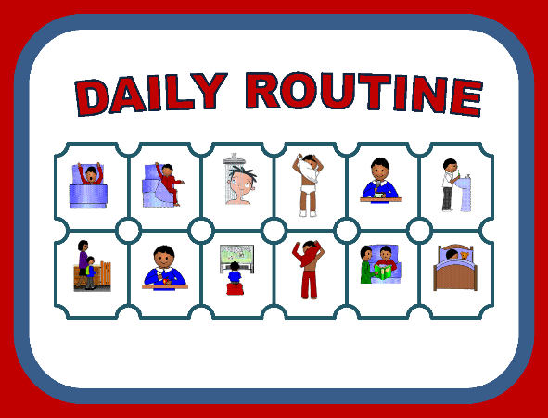
Routine
Establish and keep routines at home which help prepare for each day in school e.g. homework times, checking timetables, making sure that their reading diary & reading books are in their book bags etc.

Slide 23
Routine
Try to get your child to school in good time, a calm start enables them to continue in this way and they won’t feel hurried or worried about coming into class late.

Slide 24
Bedtime
Should your child have trouble sleeping or settling during the transitional phase, allow more time in the lead up to bedtime for your child to share their wonderful new experiences and any concerns.
This will provide him or her with the opportunity to talk about their day before they get into bed.
Playing music or a story tape very quietly in the background may serve to offer reassurance.
Seek advice if settling at bedtime becomes an issue.

Slide 25
Bedtime
A few days before the start of term, try to ensure that your child goes to bed a little earlier.
Once term starts they will tire easily regardless of their age as they experience new routines and experiences.
Planning quieter weekends at the start of term will allow them time to relax and rest.

Slide 26
What about me?
Be kind to yourself on the first day of term, it is understandable to feel sad or upset after you have said goodbye to your child, particularly if they were crying before you left.
Most children calm down quickly and settle to an activity within a minute or two of you leaving.
Do trust that a member of staff will contact you if your child continues to be tearful.

Slide 27
What did your children say that they wanted from you?
All of the children in Foundation Stage, Year 1 & Year 2 took part in a class circle time to talk about how they felt about moving on, the ways that teachers could support them and about what parents could do to help them.
We have listened to their important views and ideas and this has shaped our transition plan.

Slide 28
What did your children say that they wanted from you?
’Extra hugs’
‘Families could send us letters to make us feel better like they did after parents evening.’
‘Mums & Dads to say goodbye to us at the gate in the mornings…… to get us ready.’
‘They could help us to be a bit more independent.’

Slide 29
What did your children say that they wanted from you?
‘They could help me to be a bit more confident.’
‘Teach you to do laces up.’
‘Visit our new class on open evening and our own class, to see what’s different.’
‘They can encourage you to feel happy & confident…. use encouraging words.’

Slide 30
What did your children say that they wanted from you?
‘Make sure we have the right uniform.’
‘Invite friends over that are going to be with you as well as those who are going somewhere else.’
‘They can show us photos on the school website.’
‘To put our own things in our book bag.’

